Slide 1

Complete Graph Distance (CGD) in Facial Keypoint Detection using Deep Learning
Hosneara Ahmed
U00744746

Slide 2
Introduction
Object detection is a challenging problem compared to classification
Localize a human face
Facial keypoints detection is a bit different than face detection
Coordinates of nose, lip, eyes, eyebrows, etc.
Transfer learning to detect facial keypoints
Pretrained model, finetune as needed
ResNet, DenseNet, etc.
MSE loss to penalize the model
Does not have any aware of the shape!
Weighted CGD along with MSE

Slide 3
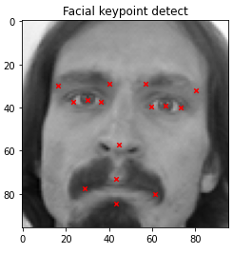
Methodology
Dataset[1]
15 facial keypoints ((x,y) points, 30 features)
7049 training images, 1783 test images
Each image size: 96x96x1
Left eye center, left eye inner corner, left eye outer corner, right eye center, right eye inner corner, right eye outer corner, left eyebrow inner end, left eyebrow outer end, right eyebrow inner end, right eyebrow outer end, nose tip, mouth center, mouth left corner, mouth right corner
[1] https://www.kaggle.com/c/facial-keypoints-detection

Slide 4
Methodology (cont.)
Missing data handling – forward filling
Fill the missing values with last observed value
Image augmentation – rotation, noise, brightness
Transfer learning
Pretrained ResNet, DenseNet
Loss function: Complete Graph Distance (CGD)

Slide 5
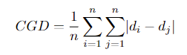
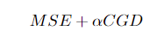
Complete Graph Distance (CGD)
Inspired from [2], consider the distance among keypoints along with MSE to learn the structure of the keypoints
Each keypoint is a node in a graph, calculate all possible keypoint distance and take the average
d_{i} = keypoint, n = number of keypoints, α = 0.01
[2] Abdullah-Al-Zubaer Imran, Chao Huang, Hui Tang, Wei Fan, Kenneth M. C. Cheung, Michael To, Zhen Qian, and Demetri Terzopoulos. Bipartite distance for shape-aware landmark detection in spinal x-ray images, 2020

Slide 6
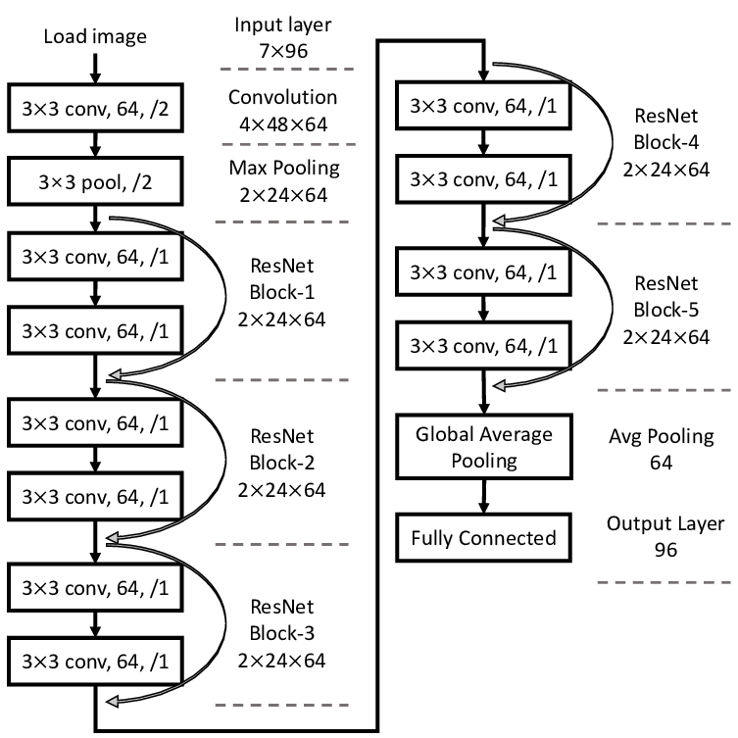
Model Architecture (Resnet-50)[3]
Deep CNN network
Skip connections after each 3 convolution layer in ResNet-50
Does not degrade learning
Resolves vanishing gradient problem
Gradients flow through the shortcut connections
Figure-1: ResNet
[3] https://iq.opengenus.org/resnet50-architecture/

Slide 7
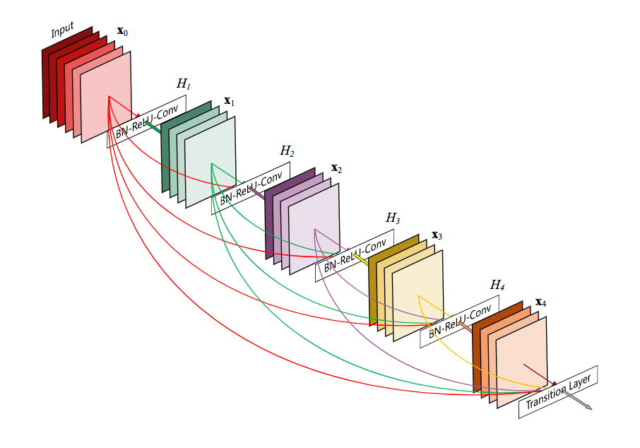
Model Architecture (DenseNet-121) [4]
Connections from all previous layers
Inputs of each layers contains feature maps from all previous layers
Feature re-use
Fewer parameters
[4] https://towardsdatascience.com/understanding-and-visualizing-densenets-7f688092391a

Slide 8
Experimental Setup [5]
Pretrained ResNet-50 and DenseNet-121
With and without image augmentation
Batch size = 64
Decaying learning rate factor = 0.7
Number of epochs = 200
Optimizer = Adam
[5] https://www.kaggle.com/lqdisme/facial-keypoint-detection-cnn-augmentation

Slide 9
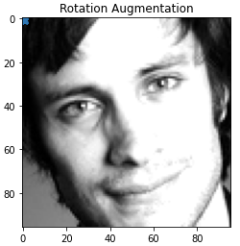
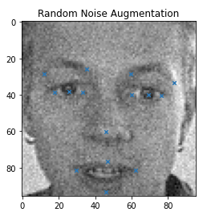
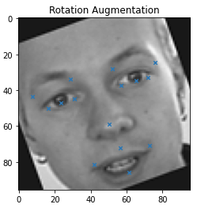
Image Augmentation
Rotation: 20° and - 20°
Noise: Random normal noise with mean=0, variance=0.1
Brightness: +/- 50%
Brightness

Slide 10
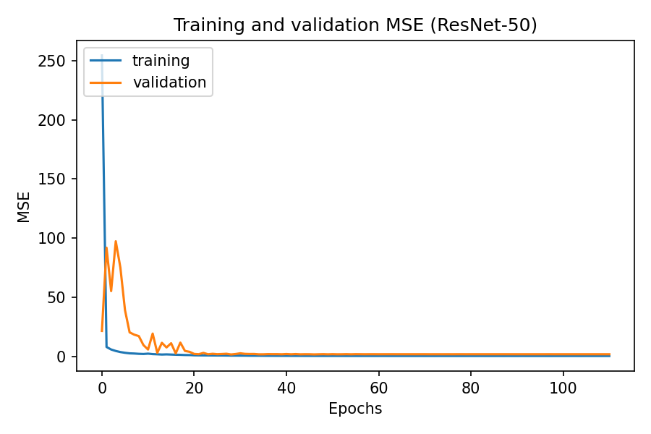
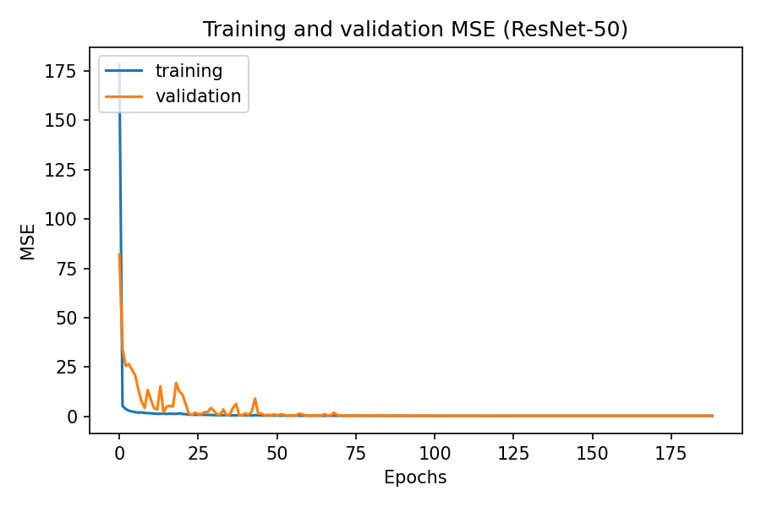
Results
ResNet-50 with MSE loss
With Image Augmentation
Without Image Augmentation

Slide 11
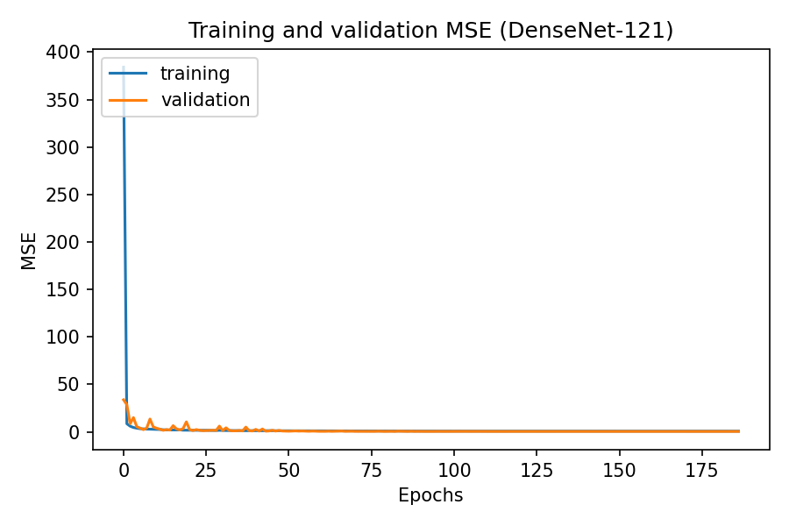
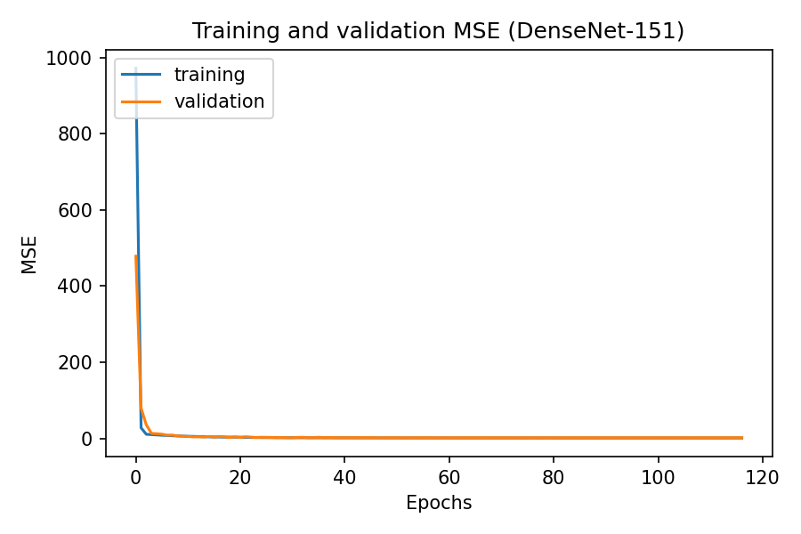
Results (cont.)
DenseNet-121 with MSE loss
With Image Augmentation
Without Image Augmentation

Slide 12
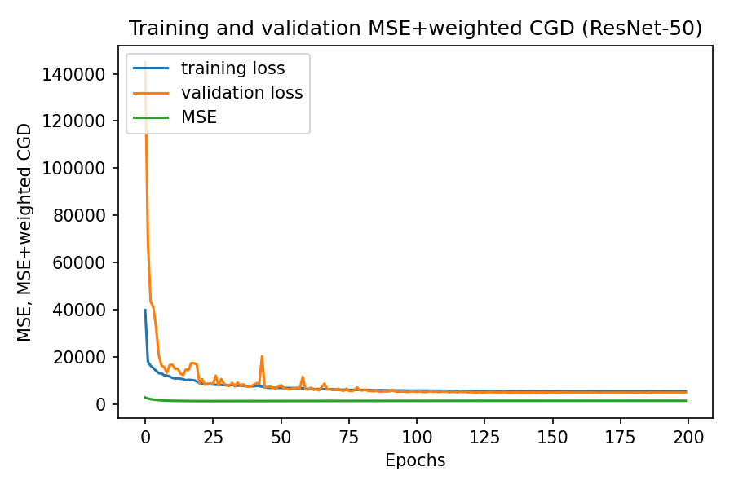
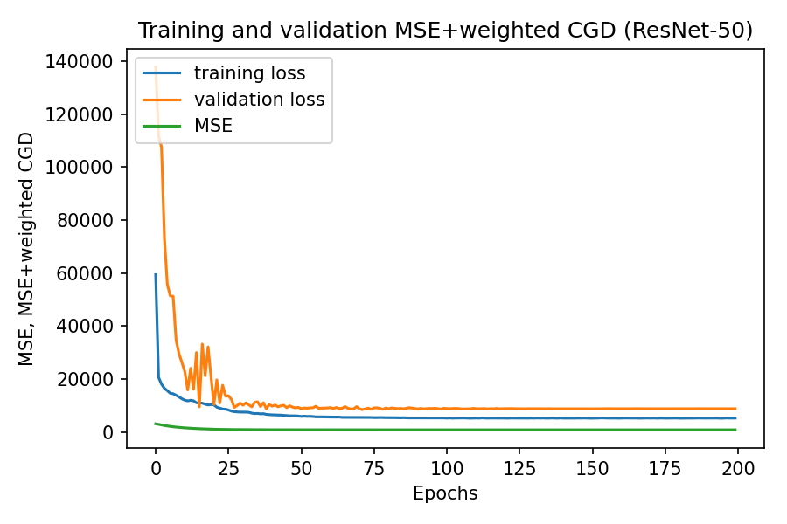
Results
ResNet-50 with CGD loss
With Image Augmentation
Without Image Augmentation

Slide 13
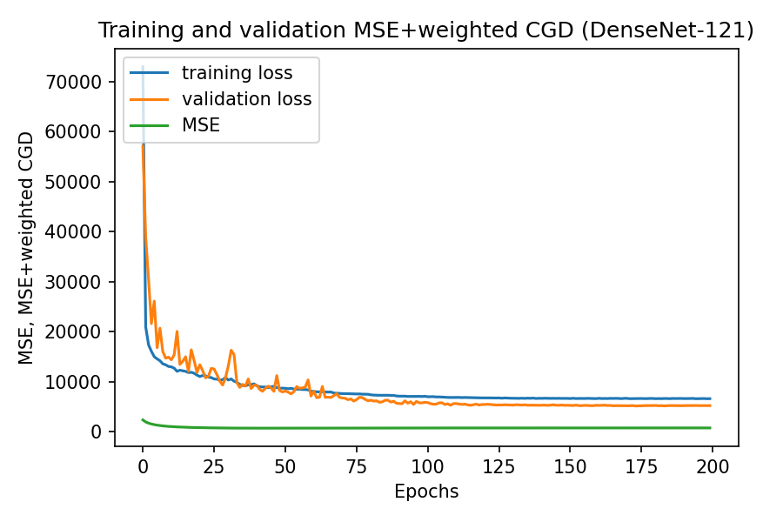
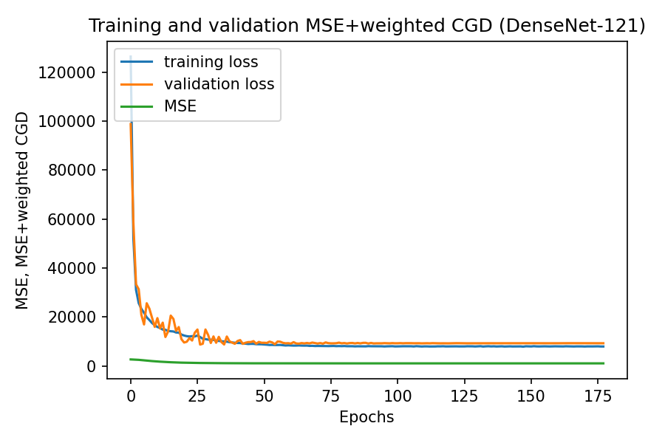
Results (cont.)
DenseNet-121 with CGD loss
With Image Augmentation
Without Image Augmentation

Slide 14
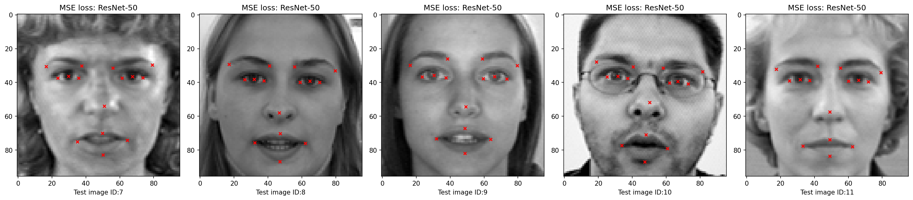
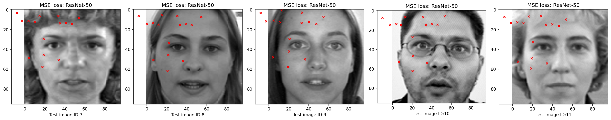
Prediction: MSE vs CGD (ResNet-50)
MSE
CGD

Slide 15

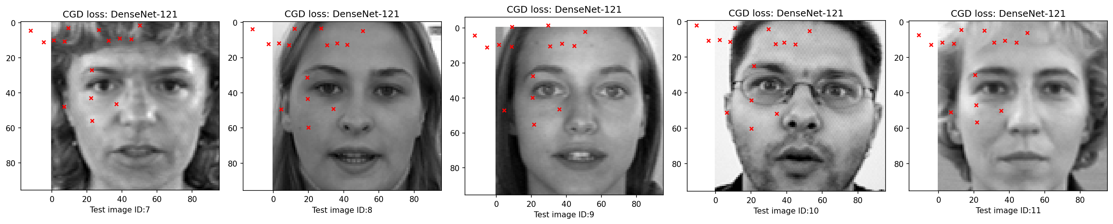
Prediction: MSE vs CGD (DenseNet-121)
MSE
CGD

Slide 16
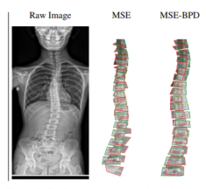
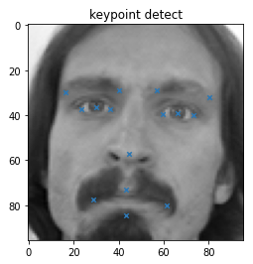
Discussion
From the MSE and CGD loss we can see that proposed CGD loss does not perform better than MSE for with or without image augmentation
The possible reason might be the dataset difference
Spinal X-ray image data[2] vs facial keypoint dataset[1]
[1] https://www.kaggle.com/c/facial-keypoints-detection
[2] Abdullah-Al-Zubaer Imran, Chao Huang, Hui Tang, Wei Fan, Kenneth M. C. Cheung, Michael To, Zhen Qian, and Demetri Terzopoulos. Bipartite distance for shape-aware landmark detection in spinal x-ray images, 2020

Slide 17
Conclusion
We have incorporated Complete Graph Distance (CGD) loss in ResNet-50 and DenseNet-121 model
Shape awareness depends on the data being used
In future, we can explore CGD loss for a different dataset like spinal X-ray images where the distance structure can be learned

